Slide 1

Analysis of Process Schedulers
By:
Nathan DeKeyrel and Wade Fortson

Slide 2
Goals of Project
We wanted to provide a somewhat comprehensive analysis of the various scheduling algorithms we saw in class
While researching scheduling algorithms, we found the Completely Fair Scheduler, which is used in the Linux Operating System
We wanted to compare some of the algorithms from class against one used in a modern operating system

Slide 3
Background
In class, we saw 6 different scheduling algorithms
FCFS, RR, SPN, SRT, HRRN, and FB
For our analysis we decided to test
Basic: FCFS and RR
Theoretically Optimal: SPN and SRT
Fair Scheduler: CFS
With the focus being on CFS
Notes:
First Come First Serve, Round Robin, Shortest Process Next, Shortest Remaining Time, and Feedback

Slide 4
CFS in Linux
The main scheduler used by the Linux Kernel Since 2007
Uses Red-black tree for sorting – O(log n) insertion and deletion
Inspired by ‘Ideal Fair Queueing’ in network packet scheduling
Replaced the O(1) scheduler previously used

Slide 5
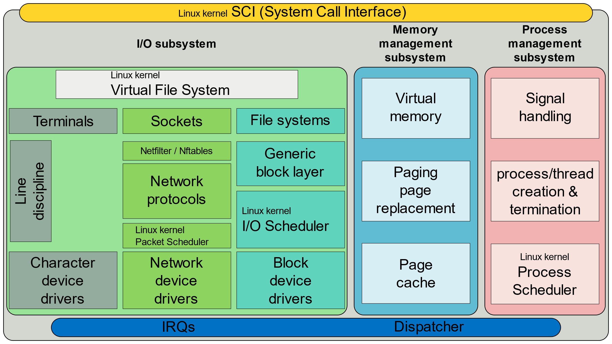
Simplified Linux Diagram

Slide 6
O(1) Scheduler
Did not contain any algorithms that ran worse than O(1) time
Every part of scheduler guaranteed to complete in an upper-bounded, definite time regardless of the size of input
Algorithm
Uses 2 arrays – Active and Expired
Each process given fixed time quantum
After exhausted, preempted and moved to Expired
Once active emptied, swap arrays (using pointers) and repeat

Slide 7
Issues with O(1) Scheduler
Identifies interactivity based on average sleep time
Processes that wait for user input could be assumed inactive
Gives priority to interactive tasks
All calculations to determine interactivity are prone to miscalculation
High complexity
Extremely complicated algorithms with many edge cases
Unpredictable
Prioritizing response to user input can cause random shift in ordering
Penalizing non-interactive by lowering priority

Slide 8

Design of CFS
Goals
Reduce complexity – No special cases
Fair CPU distribution across processes
Better responsiveness – no misclassification of tasks
Predictable

Slide 9
CFS Algorithm
Task – minimal entity that can be scheduled
Can also be a group of threads, leading to schedulable entities
Sorts schedulable entities in tree based on time
Minimum vruntime stored in leftmost node
Maximum execution time based on ‘ideal processor’
Calculated as time_waiting/total_num_of_processes

Slide 10
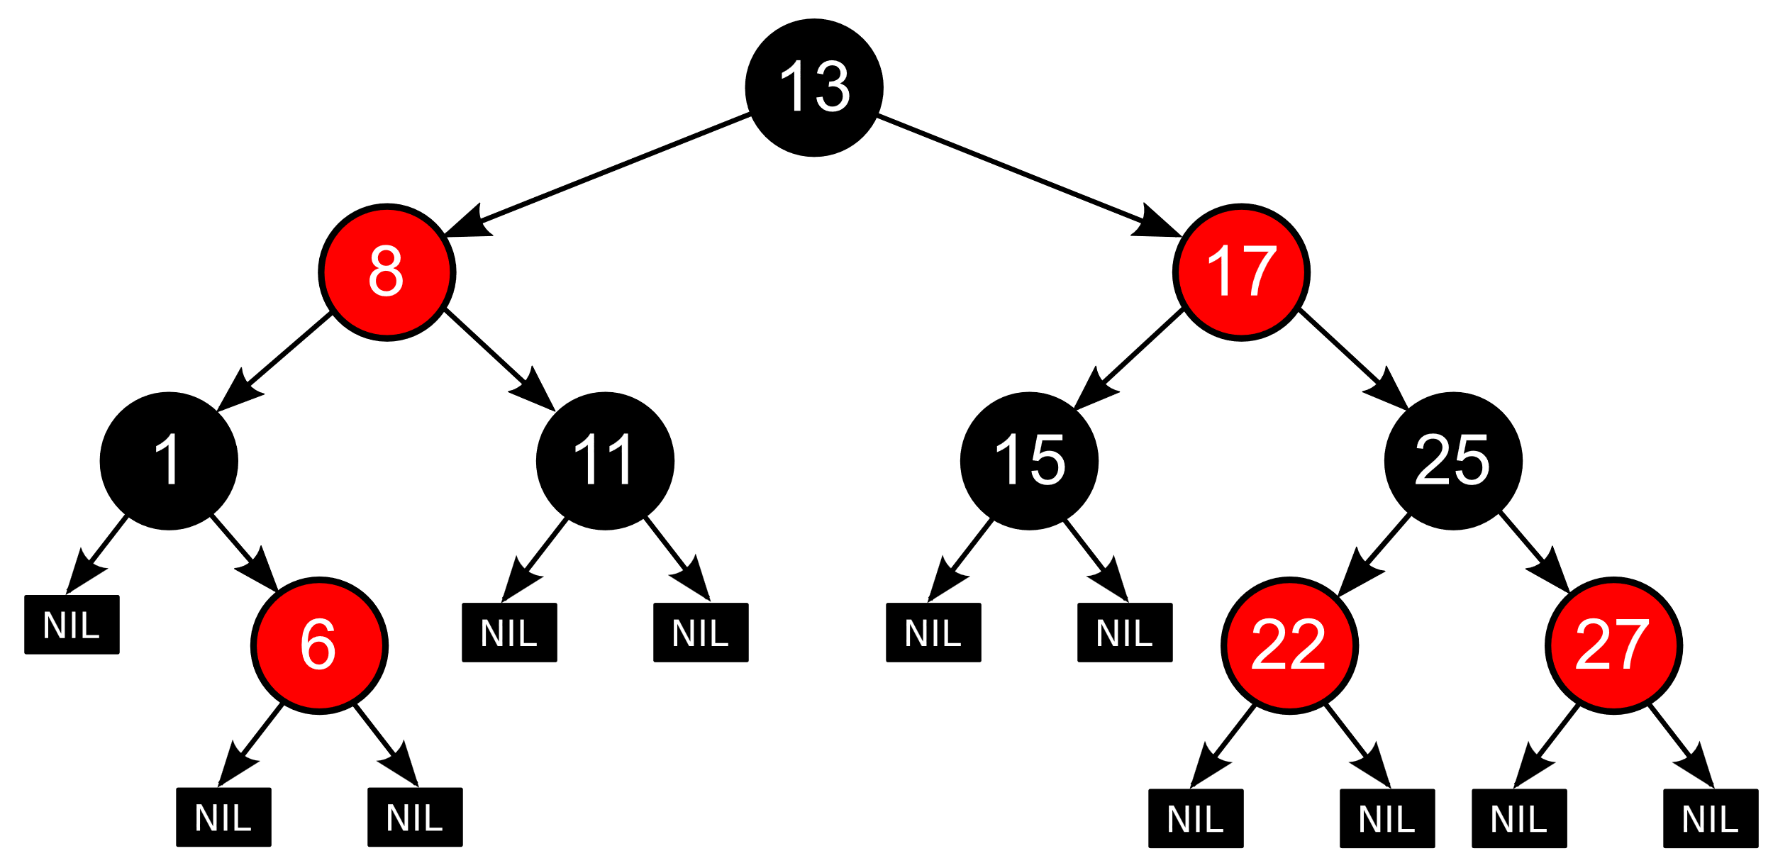
Rbtree recap
Need to put short recap on rbtrees
Something on self-balancing
Node attributes
Operations
Height constraints
Guarantees O(log n) insertion and deletion
Not ‘optimal’ – faster is better

Slide 11
CFS Algorithm
When scheduler is invoked to run a new task
Leftmost node of tree is chosen and sent for execution
If process completes, remove from system and tree
If it reaches maximum execution time or is stopped, reinsert into tree
Reinsertion based on newly spent execution time
New leftmost node selected, repeating process
This ensures that process that spend a lot of time sleeping don’t get assigned a low priority – also is given a boost when it needs it
Notes:
Stopping would occur either voluntarily (within the process) or externally via interrupt
Tasks don’t get less processor time than tasks that are constantly running

Slide 12
CFS Algorithm
Key components
Track how much time each process has received (virtual runtime)
vruntime = actual_runtime * (weight₀/weight_{process})
Normalize by process weights (nice-value)
Min vruntime is executed next
Time slices
Dynamic based on number of runnable process
Period / num_of_processes

Slide 13
CFS v O(1)
CFS
CFS
Pros
Predictable
Simple
Good for interactivity
Cons
Can lead to latency spikes
Expensive if lots of tasks
Memory overhead due to vruntime
O(1)
O(1)
Pros
Defined upper-bound runtime regardless of workload size
Cons
Unpredictable
Subject to miscalculations
Low responsiveness
Higher time complexity
“CFS Basically models an ‘ideal, precise multitasking CPU’ on real hardware” – Ingo Molnar

Slide 14
System Architecture
Initialize workloads
1
Return as csv
Parse csv
2
In C, store each task in array of structs
Run scheduling algorithms
3
Store results in a csv file
Create averages and graphs using python
4
Using python, initialize workloads
In C, track various metrics for each algorithm

Slide 15
Process design
A common process structure for every algorithm
Each algorithm would be able to schedule based on only info needed
Several workloads would be randomly generated based on:
Mixed–even distribution of each
CPU-bound heavy bursts
I/O-bound heavy bursts

Slide 16
Process Design
We created a general process struct holding information relevant to each scheduler
We categorized attributes into
Basic
Timing
CFS specific
State
Queue Management

Slide 17
Process Design
Base attributes needed for all schedulers
pid
base_priority
Timing – contains attributes needed for each scheduler
arrival_time
first_run_time
completion_time
service_time
burst_time
remaining_time
Notes:
Timing – not all attributes are needed for each scheduler, but it contains information relevant to each of them
burst_time used for spn/srt

Slide 18
Process Design
CFS specific attributes
vruntime
rb_node
State
We decided to use an enum for
NEW, READY, RUNNING, WAITING, and COMPLETED processes
Queue Management
Keep track of next and previous process in queue

Slide 19
Show code

Slide 20
Metrics
Response Time
Calculated as
Turnaround Time
Calculated as
Virtual Runtime Variance
Calculated as

Slide 21
Stats

Slide 22
Results

Slide 23
Conclusion
Section on simple algs (rr, fcfs)
…
Section on theoretically optimal algs (spn, srt)
Something along the lines of “while these algorithms are technically optimal and respond to deadlines well (maybe). In real systems, you generally don’t have enough information to properly utilize these algorithms

Slide 24
Conclusion
How CFS did

Slide 25
Final Thoughts
Generally, the drawbacks of CFS aren’t noticeable
For most cases, the default CFS algorithm works well enough
In modern OS, there usually aren’t enough tasks to cause performance decreases
For specialized cases, tuning options are available within the Linux kernel
For real-time tasks, the Linux kernel makes 2 separate schedulers available
SCHED_RR and SCHED_FCFS
If you have a highly specialized system, you can make a scheduler to fit your needs as the Linux kernel is malleable

